Slide 1


Digital Mechanic
FYP Final Defense Presentation
Supervisor: Sir Abdur Rehman
Group ID: BSCS-2019
By
Masood Ur Rehman (CS120192033, GPA: 3.13)

Slide 2
Background
As the number of vehicle increases, people face a lot of issues like, hiring a mechanic, finding tools and parts etc.
The worst thing is that there is not a single online platform exists that solves all these problems.
Digital Mechanic is a Web and Mobile based Platform that has aim to provide remarkable mechanic services at your door step. Plus people could also buy related tools and equipment’s.

Slide 3
Motivation
Motivated by the lack of proper mechanic shops in our university area.
Many people face issues and also sudden breakdowns with their cars and bikes.
Minimize time consumption and energy wastage.
Aim to create quality job opportunities.

Slide 4
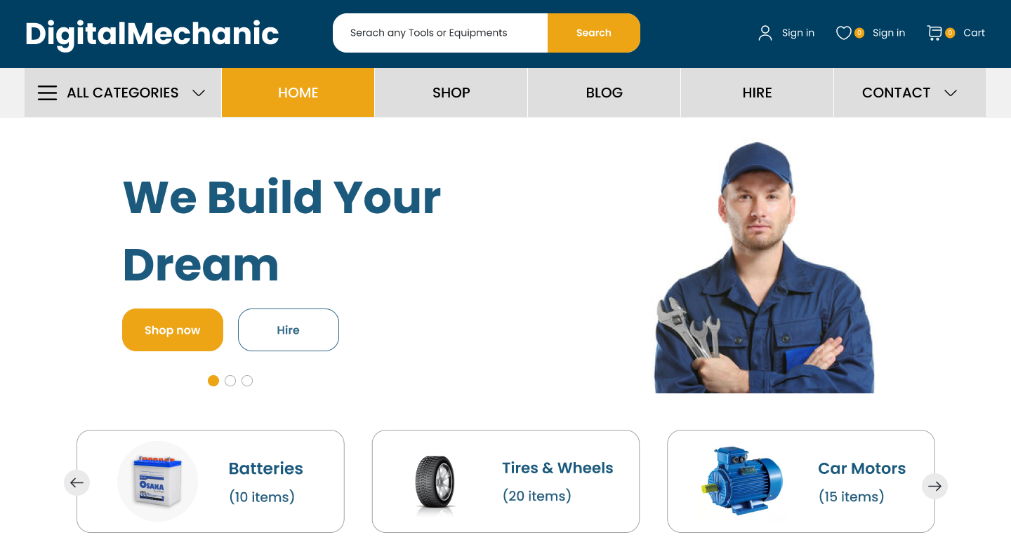
Introduction
This application will be simple, easy to understand and user-friendly.
Digital Mechanic will help people with booking expert mechanic services to buying related tools and equipment's.
The payments will be made using Stripe Gateway or PayPal.
We are also going to add a blog that will help us to spread awareness with blog posts.

Slide 5
Proposed Solution
So, according to the current system we concluded that there must be a technological solution for mechanic shop to facilitate people.
Users will be able to book a mechanic services at specific location.
User will be able to purchase parts, tools and equipment's.
The admin of the shop will be able to manage the orders, blogs and products using his admin dashboard.

Slide 6
Literature
We have the following applications that tries somehow to solve this issue but are not yet succeeded.
Mechanic USTAAD:
User can only book a mechanic.
No proper way to register a new mechanic.
Careem:
User can only drive, order, get a ride but there is no way to book a mechanic and buy body parts.

Slide 7
Objectives
To reduce the time consumption, cost and human energy wastage.
To make hiring of skilled persons possible.
Fastest service and customer satisfaction will be provided.
Want to provide an easy-to-use interface.
To bring mechanic shop online by building both web and mobile application.

Slide 8
Methodology
Admin Modules:
User Modules:
Manage Orders
Manage Services
Manage Payments
Manage Users
Manage Bookings
Manage Blog
Items Cart
Place order
Cancel order
Track delivery
Payment
Bookings

Slide 9

Challenges
/
/
/
Tracking
Tracking feature for both service and products using separate pages.
Less Time
Creating both web and mobile application in such a short span of time.
Connectivity
Connecting backend to both of the applications (web and mobile).

Slide 10
Workflow
2 Months
2 Months
Analysis and Proposal Writing
Thesis Writing & Final Evaluation
4 Months
4 Months
Designing
(UI/UX)
Code Completion and Testing

Slide 11




Tools and Technologies
Front End
Back End
Database
Other
HTML5
CSS3
JavaScript
React
Tailwind
Node Js
Express Js
MongoDB
Git
GitHub

Slide 12
FYP GitHub Repositories
Web Client Code- https://github.com/cwmservices/digitalmechanic-web-client
Mobile Client Code- https://github.com/cwmservices/Digital-Mechanic-Mobile-Client
Server/Backend Code- https://github.com/cwmservices/digital-mechanic-server
Documentation- https://github.com/cwmservices/FYP-Documentation/tree/master

Slide 13
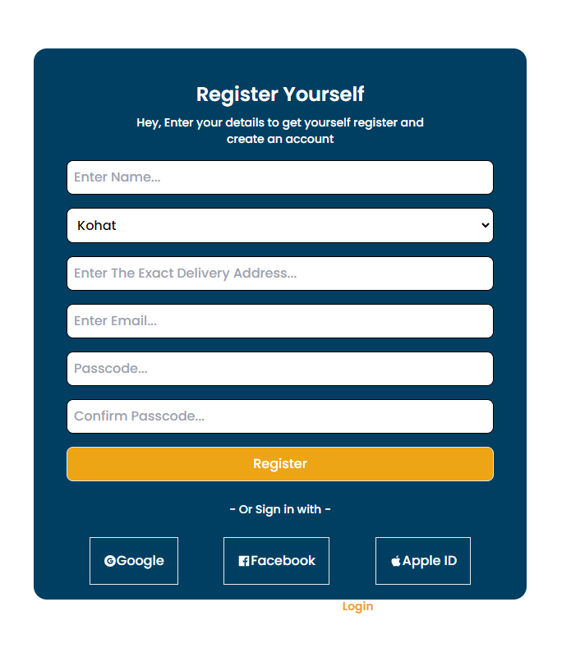
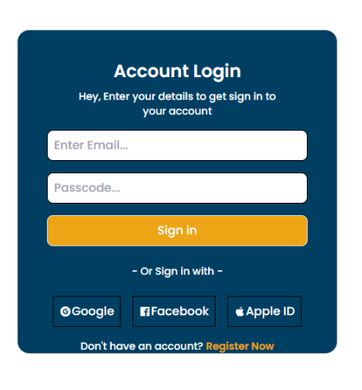
Website Screenshots
User Registration/ User Log In

Slide 14
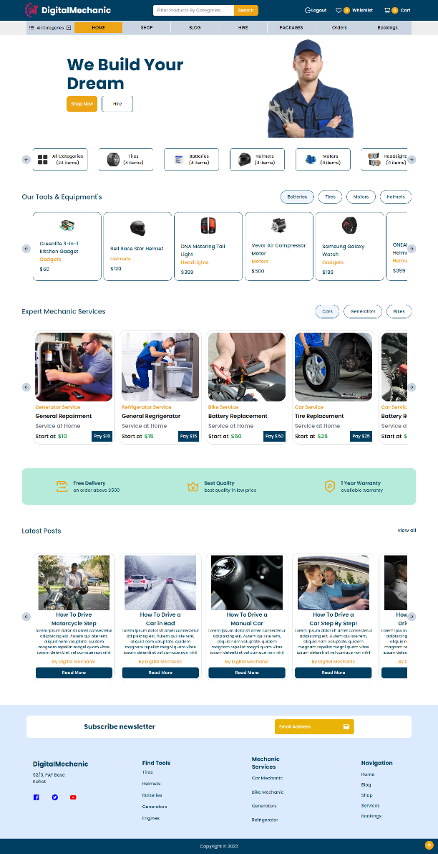
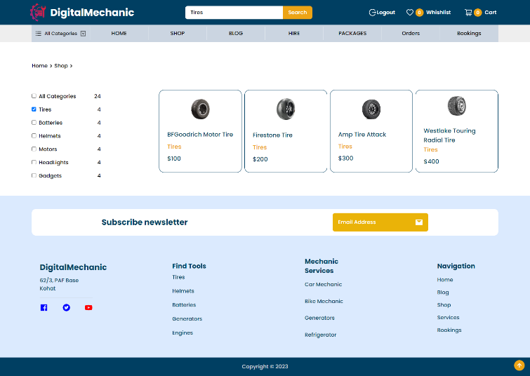
Website Screenshots
Home Page and Categories

Slide 15
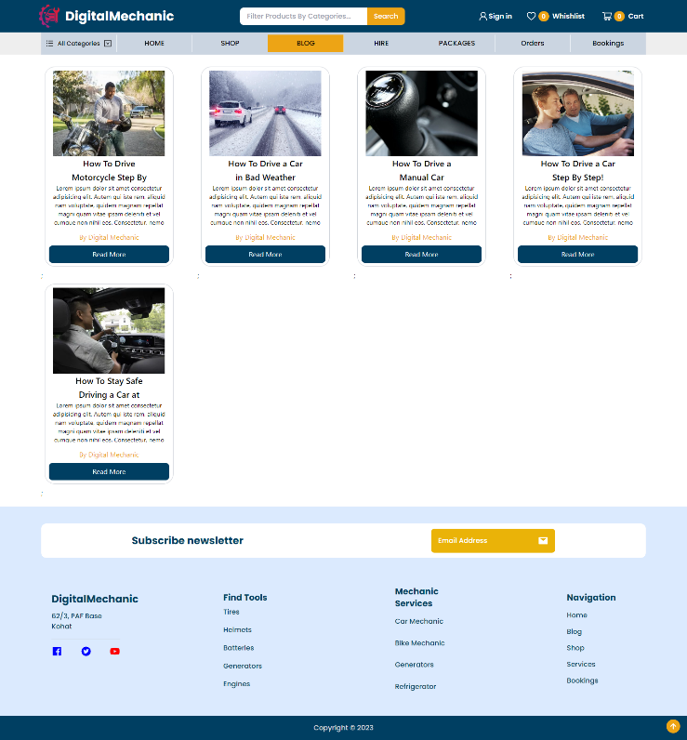
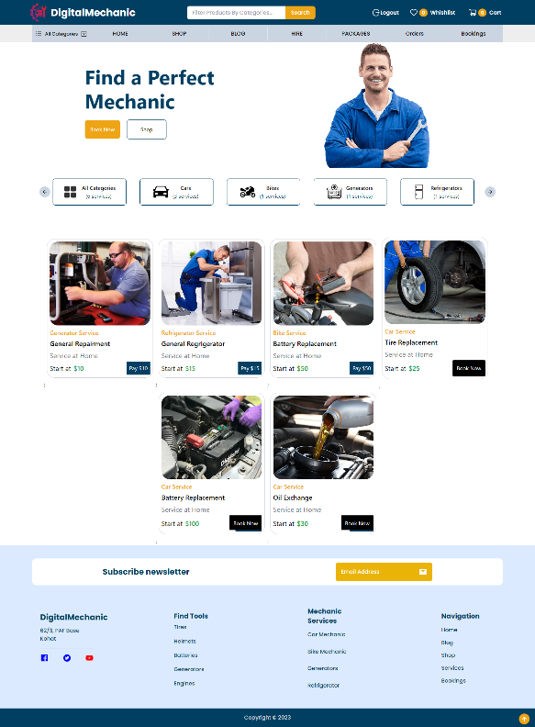
Website Screenshots
Check blogs, products and services

Slide 16
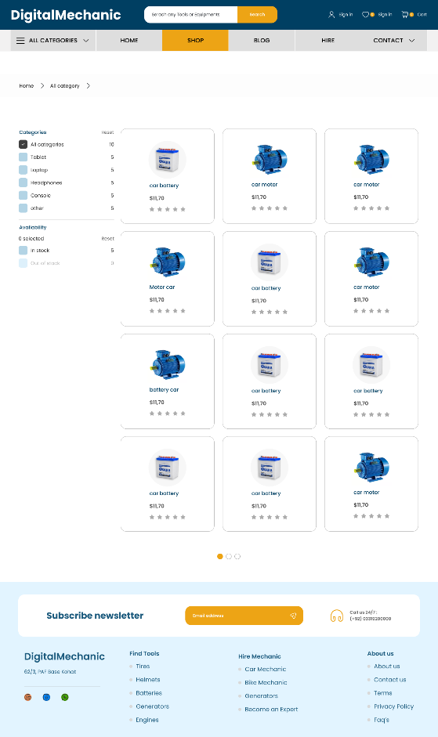
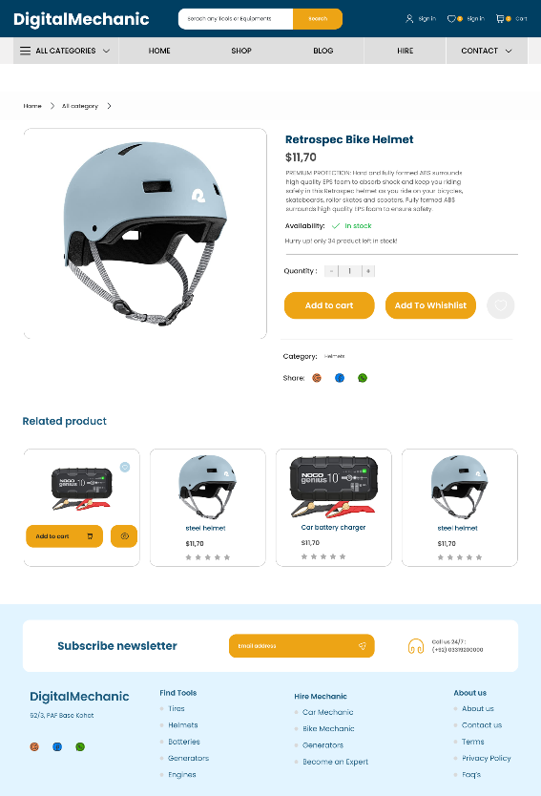
Website Screenshots
Visit the Shop page

Slide 17
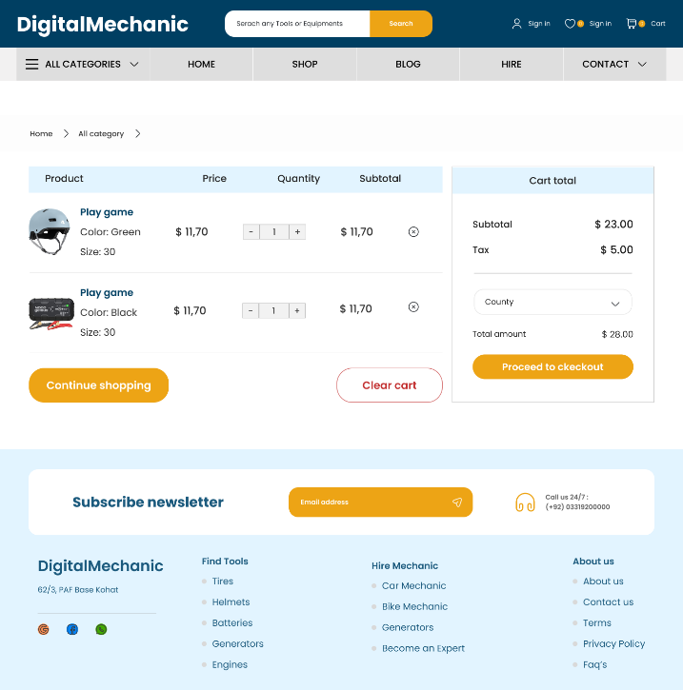

Website Screenshots
Add items to cart/Wishlist

Slide 18
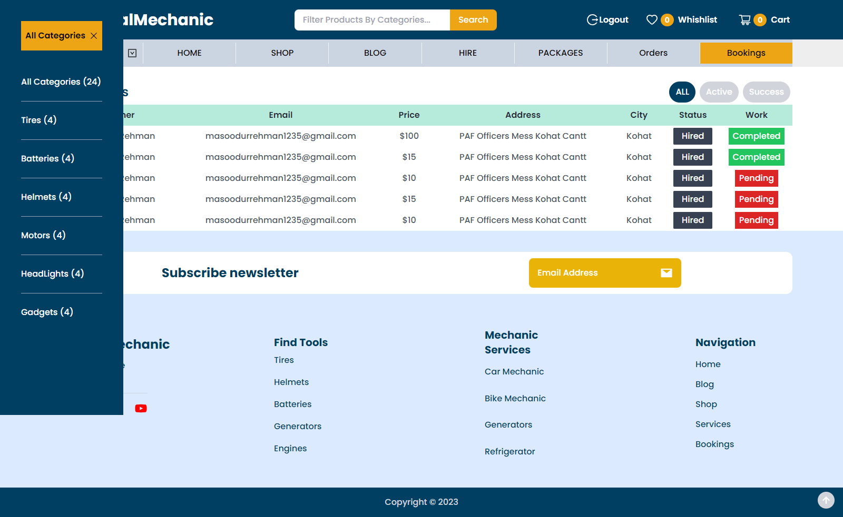
Website Screenshots
Check your orders

Slide 19
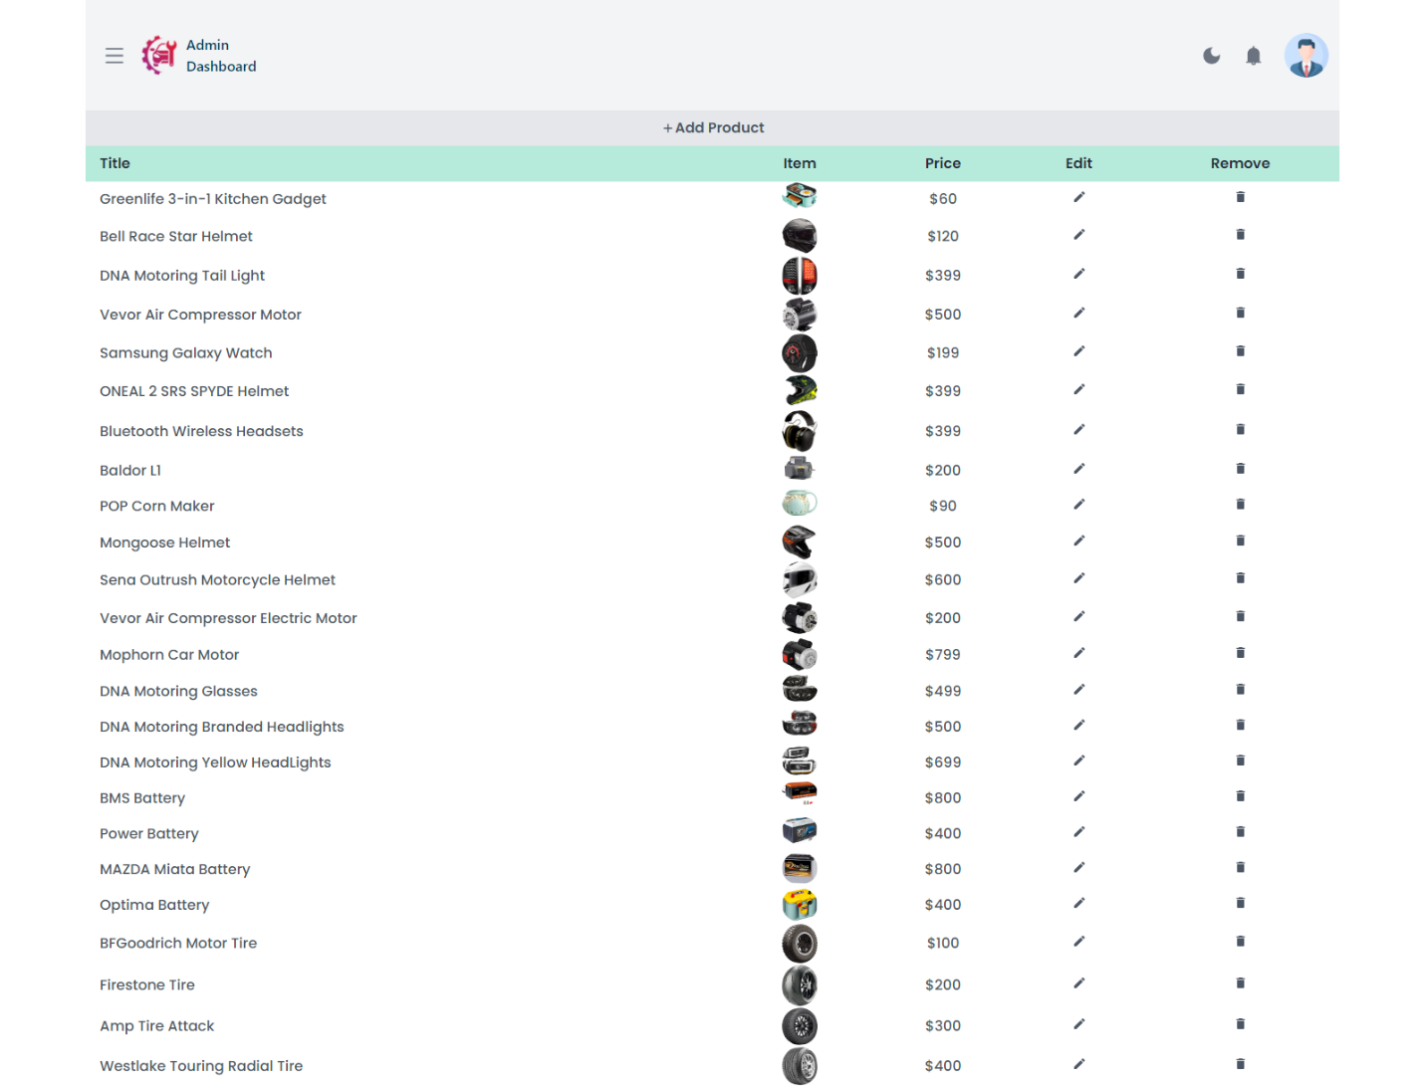
Website Screenshots
Add and remove products
By clicking on the
Add products button
Admin can add products
And then the products
Added by admin will
Be live on frontend.

Slide 20
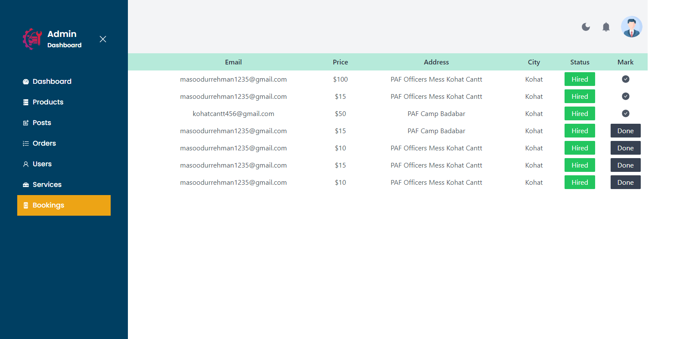
Website Screenshots
Update the status of products

Slide 21
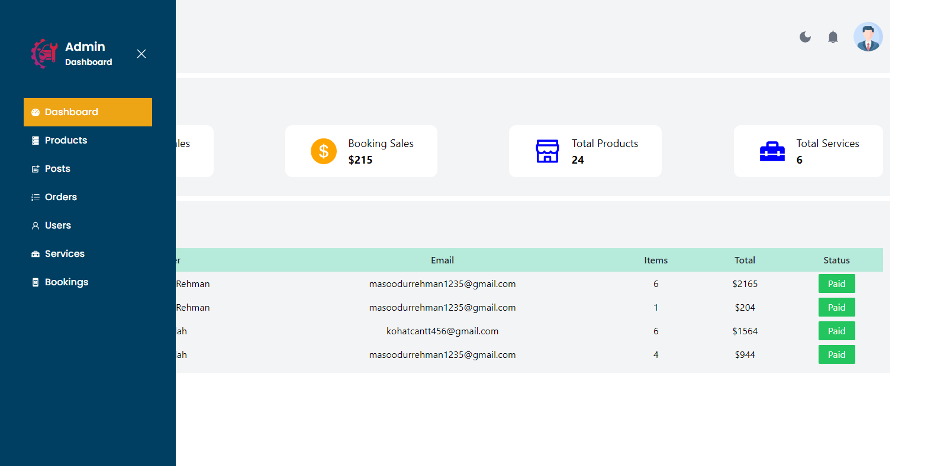
Website Screenshots
Enable dark mode/Dashboard

Slide 22
Thanks!

